Slide 1

Data Structures Foundations & Type Management
From memory architecture to type casting — a practical guide for understanding how data lives, moves, and transforms inside your programs.
MODULE 2
CS FUNDAMENTALS

Slide 2


Why This Lesson Matters
Algorithms vs. Data Structures
Algorithms are the step-by-step instructions for solving problems. Data Structures are the architectural art of organizing data in memory. You need both — a brilliant algorithm is useless on poorly organized data.
💡 Google's advertising algorithms are powerful, but completely useless without optimized backend data structures holding user information.
Most software bugs in real-world projects trace back to improper data organization or type handling errors.

Slide 3
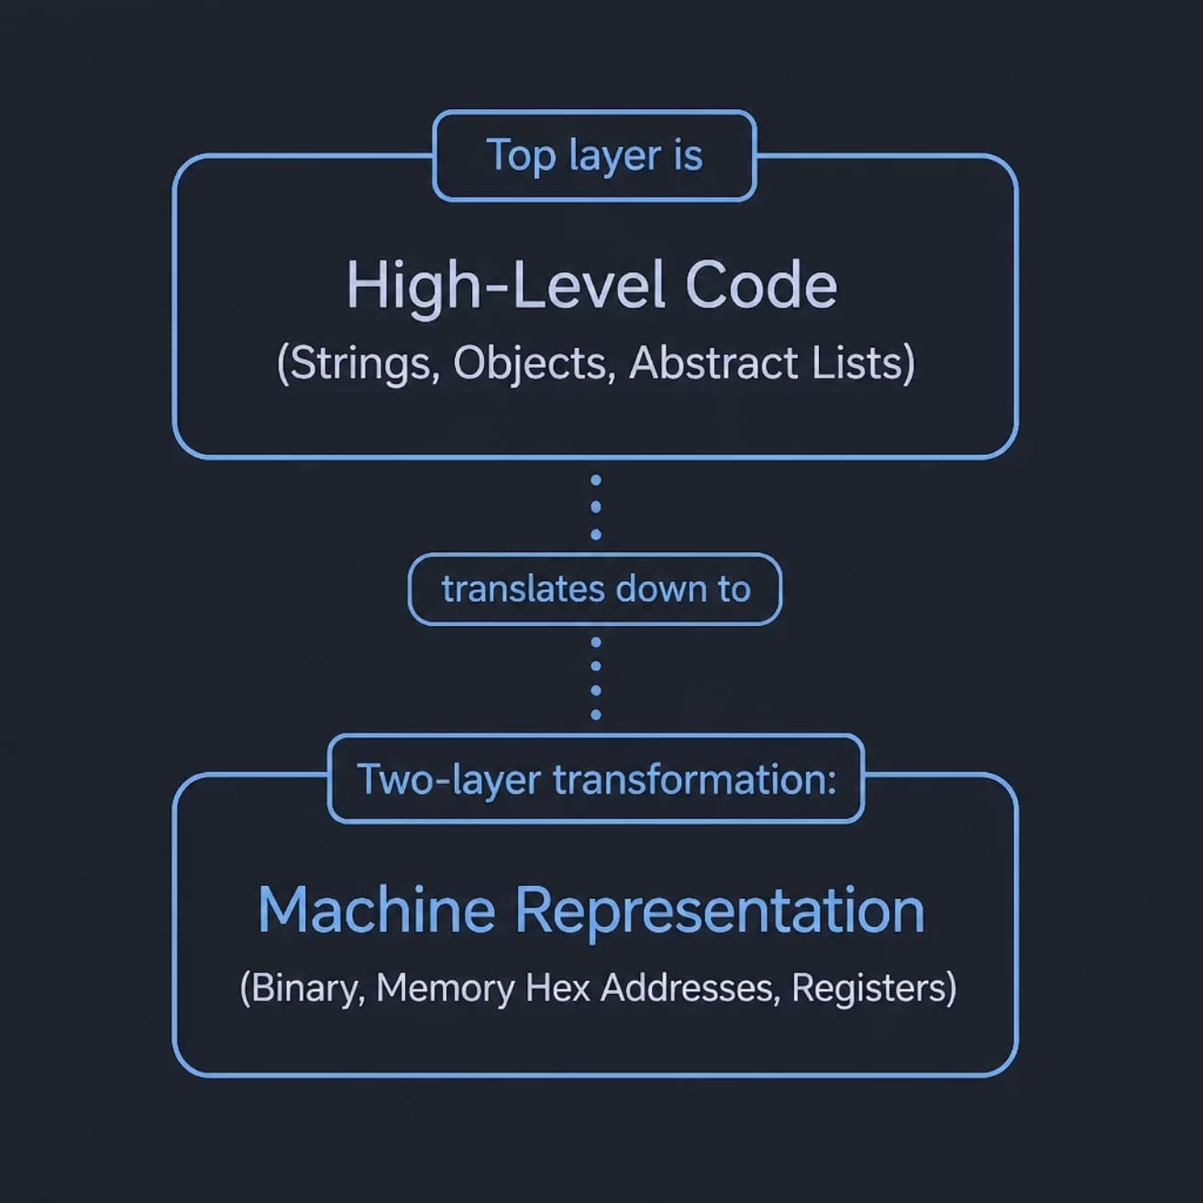
What Is a Data Structure?
A data structure defines how data is organized to match the physical constraints of machine memory — bridging human-readable code and hardware-level representation.
The Two Layers
High-Level Code — what you write: strings, objects, abstract lists.
Machine Representation — what the hardware sees: binary, hex addresses, memory registers.
Data structures are the translation framework between these two worlds.

Slide 4
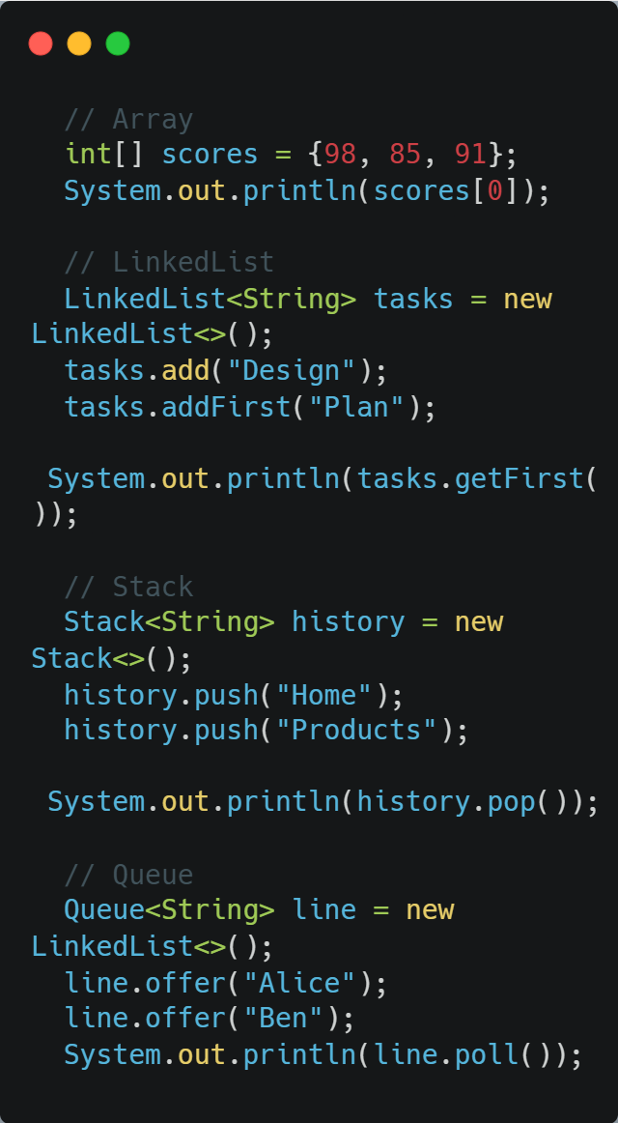




Four Ways to Organize Data
Array
Post office boxes — fixed, numbered, instantly accessible by index. Size is locked once built.
Linked List
Scavenger hunt — each item holds the address of the next. No random access; elements scattered in memory.
Stack (LIFO)
Plate dispenser — push and pop from the top only. Last in, first out.
Queue (FIFO)
Cinema ticket line — first to arrive is first served. Insert at rear, remove from front.

Slide 5
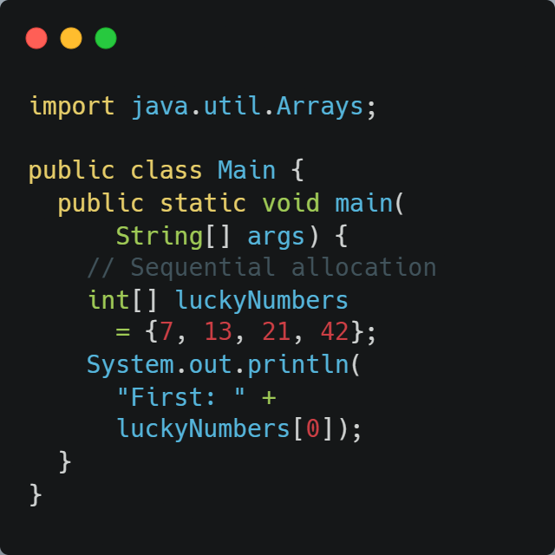
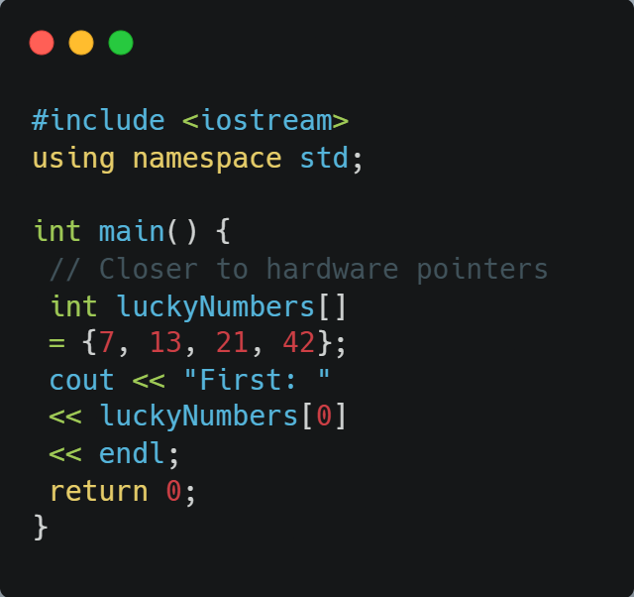
Arrays in Code: Java vs. C++
Both languages allocate array elements sequentially in memory, but C++ sits closer to the hardware while Java manages memory through garbage-collected abstractions.
Java
C++

Slide 6
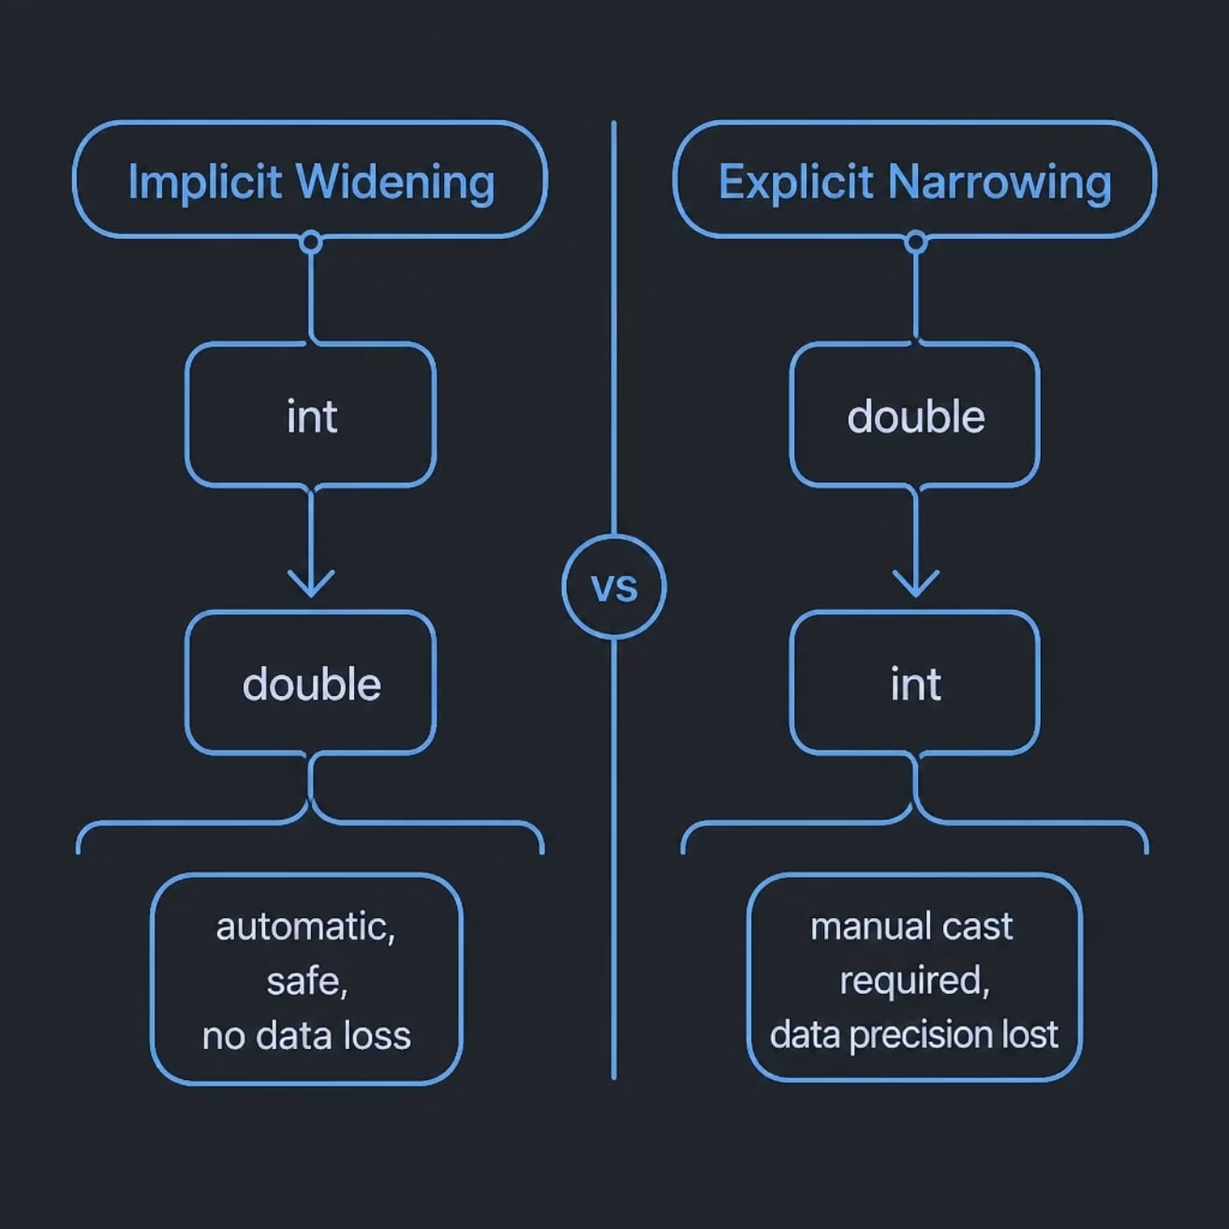

Type Casting: Implicit vs. Explicit
When moving data between variables of different sizes, the compiler either helps you silently — or forces you to take responsibility for potential data loss.
Implicit — Widening
Explicit — Narrowing
Smaller → Larger type. Zero risk of data loss. The compiler handles it silently.
int (32-bit) → double (64-bit) ✓ Safe
Larger → Smaller type. Risks precision loss (e.g., decimal places sliced off). You must declare it manually.
double → int ⚠ Data lost!

Slide 7
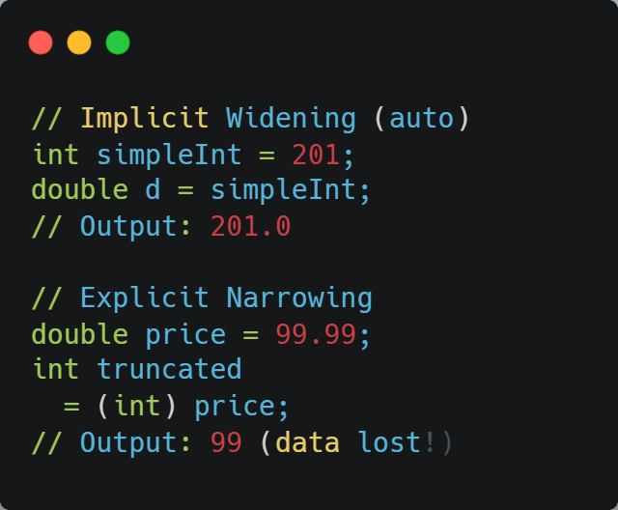
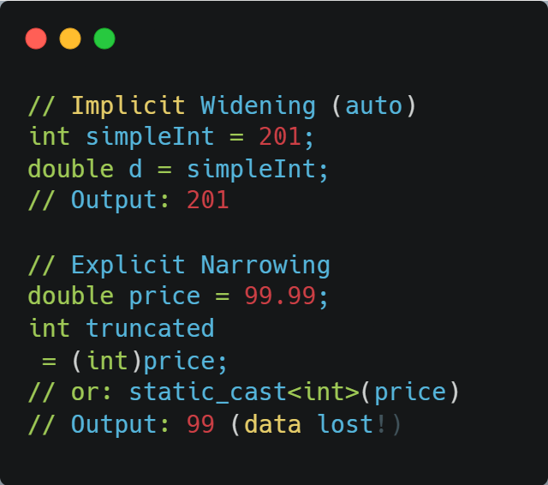
Type Casting in Practice: Java vs. C++
Both languages share the same casting logic — implicit widening happens automatically, while narrowing requires a manual cast. C++ additionally offers static_cast<> as a more explicit alternative to C-style casting.
Java
C++

Slide 8
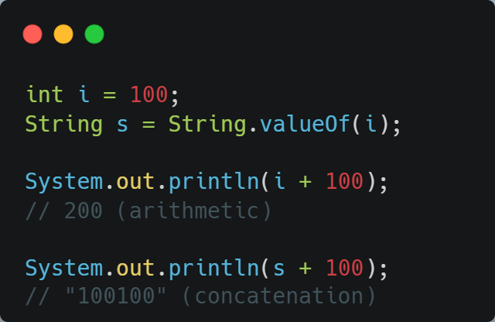
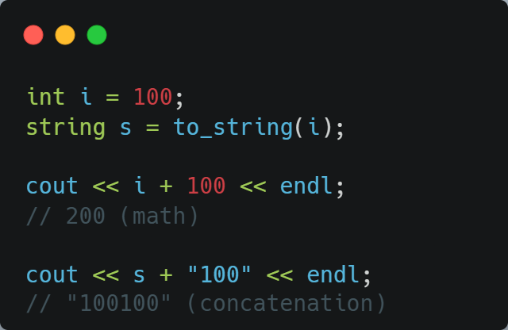

Primitive to Object: Numbers Become Strings
Sometimes you need to transform a numeric value into a String object — especially when formatting output for users. The + operator behaves very differently depending on the operand types.
Java — String.valueOf()
C++ — std::to_string()
⚠️ Once converted to a String, the + operator switches from arithmetic addition to text concatenation — a classic source of silent bugs.

Slide 9


Key Takeaways
Choose the Right Structure
Arrays for indexed lookup. Linked Lists for flexible insertion. Stacks (LIFO) and Queues (FIFO) for ordered task execution.
Respect Type Boundaries
Always identify whether an assignment triggers implicit widening (safe) or explicit narrowing (data precision discarded).
Know Your Abstraction Layer
C++ addresses hardware registers directly; Java wraps memory management in garbage-collected object libraries. Both are valid — choose based on your constraints.

